Slide 1







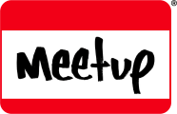
https://twitter.com/appclubim https://www.youtube.com/user/appclubim
https://www.facebook.com/appclub.im/ http://www.meetup.com/AppClub/

Slide 2
Microsoft Edge for Developers
Oleksandr Krakovetskyi
Microsoft Regional Director, MVP
CEO DevRain Solutions

Slide 3
Key Takeaways
Microsoft Edge is an interoperability-focused browser
Microsoft Edge supports over 45 new web standards
Our standards roadmap is open and open to feedback
We have resources for compat testing
We’re already well underway on even more features
Notes:
This slide is required. Do NOT delete. This should be the first slide after your Title Slide. This is an important year and we need to arm our attendees with the information they can use to Grow Share! Please ensure that your objectives are SMART (defined below) and that they will enable them to go in and win against the competition to grow share. If you have questions, please contact your Track PM for guidance. We have also posted guidance on writing good objectives, out on the Speaker Portal (https://www.mytechready.com).
This slide should introduce the session by identifying how this information helps the attendee, partners and customers be more successful. Why is this content important?
This slide should call out what’s important about the session (sort of the why should we care, why is this important and how will it help our customers/partners be successful) as well as the key takeaways/objectives associated with the session. Call out what attendees will be able to execute on using the information gained in this session. What will they be able to walk away from this session and execute on with their customers.
Good Objectives should be SMART (specific, measurable, achievable, realistic, time-bound). Focus on the key takeaways and why this information is important to the attendee, our partners and our customers.
Each session has objectives defined and published on www.mytechready.com, please work with your Track PM to call these out here in the slide deck.
If you have questions, please contact your Track PM. See slide 5 in this template for a complete list of Tracks and TPMs.

Slide 4

HTML4, ES3, CSS2
1995
1995
2015
1
2
3
4
4.x
5
5.5
6
7
8
9
9
10
11
Trident
Quirks
Strict
!DOCTYPE
Notes:
Even as long ago as IE6, we had to worry about adding new features while keeping backward compat
We use the “doctype” as a trigger to use the strict mode
DOCMODE is: a compat flag that turns on and off features in the SAME engine
(dozen “if” in the code, if IE9 or IE8 etc….)

Slide 5

Modern Web
HTML5, SVG, ES5, CSS3
Legacy Web
CSS2.1
HTML4, ES3, CSS2
1995
2015
1
2
3
4
4.x
5
5.5
6
7
8
9
9
10
11
Trident
IE5
Quirks
IE7
Compat View
IE8
Standards Mode
EMIE
Enterprise Mode
!DOCTYPE
x-ua-compatible
IE9
Standards Mode
IE10
Standards Mode
QME
Quirks Mode Emulation
IE11
Standards Mode
http://quirksmode.org/
Notes:
We knew it was a problem but our focus was compat for users. Meanwhile our competitors…

Slide 6
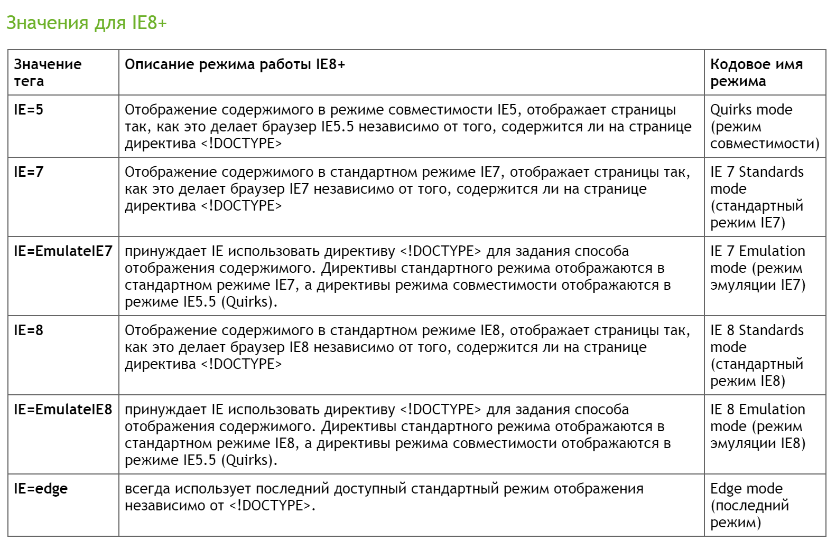
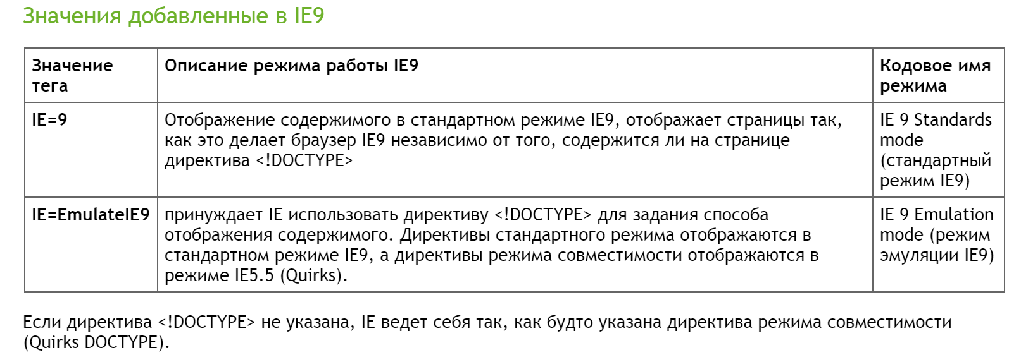
X-UA-Compatible
Notes:
This slide is required. Do NOT delete. This should be the first slide after your Title Slide. This is an important year and we need to arm our attendees with the information they can use to Grow Share! Please ensure that your objectives are SMART (defined below) and that they will enable them to go in and win against the competition to grow share. If you have questions, please contact your Track PM for guidance. We have also posted guidance on writing good objectives, out on the Speaker Portal (https://www.mytechready.com).
This slide should introduce the session by identifying how this information helps the attendee, partners and customers be more successful. Why is this content important?
This slide should call out what’s important about the session (sort of the why should we care, why is this important and how will it help our customers/partners be successful) as well as the key takeaways/objectives associated with the session. Call out what attendees will be able to execute on using the information gained in this session. What will they be able to walk away from this session and execute on with their customers.
Good Objectives should be SMART (specific, measurable, achievable, realistic, time-bound). Focus on the key takeaways and why this information is important to the attendee, our partners and our customers.
Each session has objectives defined and published on www.mytechready.com, please work with your Track PM to call these out here in the slide deck.
If you have questions, please contact your Track PM. See slide 5 in this template for a complete list of Tracks and TPMs.

Slide 7
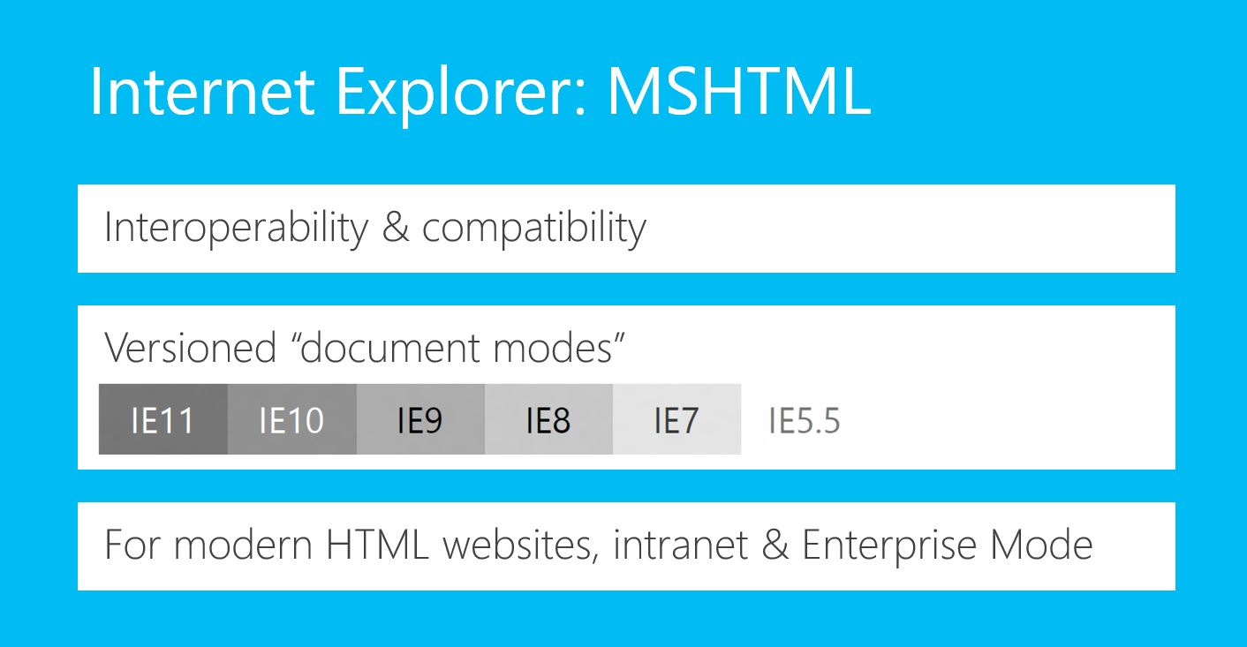
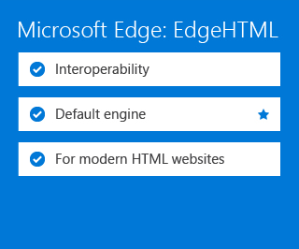
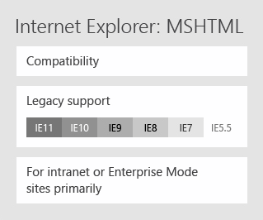
Internet Explorer: MSHTML
Interoperability & compatibility
Versioned “document modes”
For modern HTML websites, intranet & Enterprise Mode
Notes:
Fork the existing engine and bring up a new rendering engine that we could unshackle from proprietary technology burden and focus 100% on web interoperability. Let’s take a look at what it means architecturally…
In the past…
Single engine trying to serve competing priorities– both back compat with legacy IE proprietary features and interop with other browsers
To try to solve this, introduced doc modes… complicated; had a browser that operated in a number of different ways
Told all of our users to use it!
NOW:
Legacy engine, MSHTML – solely hosted in IE and focused on sites that require backwards compatibility with old IE behaviors. We think that it will be primarily used by Enterprises and intranet, as well as certain regions like Korea that have a dependency on ActiveX for now.
However, for the vast majority of Windows 10 users, there is 1 default browser – Microsoft Edge, powered by a new rendering engine.
Our goal is to help developers migrate away from MSHTML eventually.
Once we made that break, we were able to make a LOT of improvements to interop for Microsoft Edge. In fact..

Slide 8
Interoperability: a new approach

Slide 9
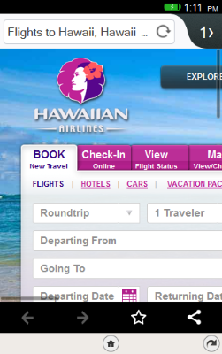
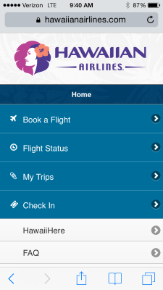
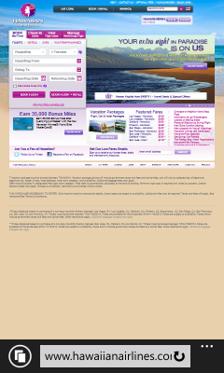

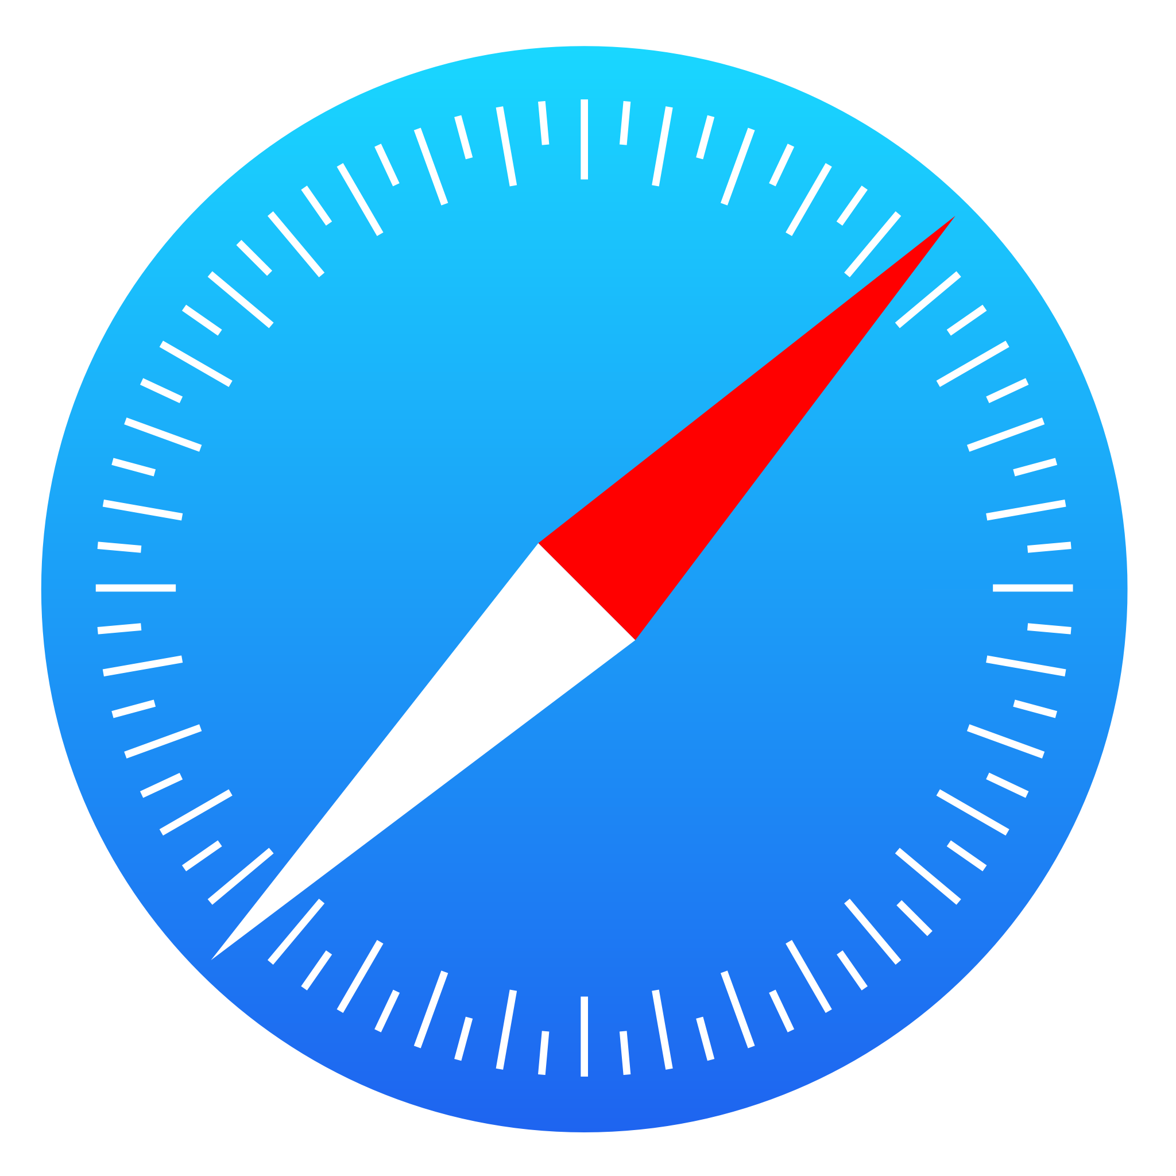

Getting the right, modern content

Slide 10



User-Agent Strings
Mozilla/5.0 (Windows NT 10.0; WOW64; rv:39.0) Gecko/20100101 Firefox/39.0
Mozilla/5.0 (Macintosh; Intel Mac OS X 10_10_1) AppleWebKit/600.1.25 (KHTML, like Gecko) Version/8.0 Safari/600.1.25
Mozilla/5.0 (Windows NT 10.0; WOW64) AppleWebKit/537.36 (KHTML, like Gecko) Chrome/44.0.2403.89 Safari/537.36
Mozilla/5.0 (Windows NT 10.0; Win64; x64) AppleWebKit/537.36 (KHTML, like Gecko) Chrome/42.0.2311.135 Safari/537.36 Edge/12.10240
http://webaim.org/blog/user-agent-string-history/

Slide 11



User-Agent Strings
Mozilla/5.0 (Windows NT 10.0; WOW64; rv:39.0) Gecko/20100101 Firefox/39.0
Mozilla/5.0 (Macintosh; Intel Mac OS X 10_10_1) AppleWebKit/600.1.25 (KHTML, like Gecko) Version/8.0 Safari/600.1.25
Mozilla/5.0 (Windows NT 10.0; WOW64) AppleWebKit/537.36 (KHTML, like Gecko) Chrome/44.0.2403.89 Safari/537.36
Mozilla/5.0 (Windows NT 10.0; Win64; x64) AppleWebKit/537.36 (KHTML, like Gecko) Chrome/42.0.2311.135 Safari/537.36 Edge/12.10240

Slide 12
Please don’t do UA sniffing The term user agent sniffing refers to the practice of Web sites showing different content when viewed with a certain user agent. On the Internet, this will result in a different site being shown when browsing the page with a specific browser. One example of this is Microsoft Exchange Server 2003's Outlook Web Access feature. When viewed with Internet Explorer 6 or newer, more functionality is displayed compared to the same page in any other browsers, because other browsers may not be able to render content specifically designed for Internet Explorer 6.

Slide 13
Please don’t do UA sniffing Please avoid UA sniffing as much as possible
Always do feature detection
(If isolating a bug) Sniff for specific browser versions
Assume unknown browsers are good
Use Modernizr (tells what HTML, CSS and JavaScript features the user’s browser has to offer) https://modernizr.com/

Slide 14
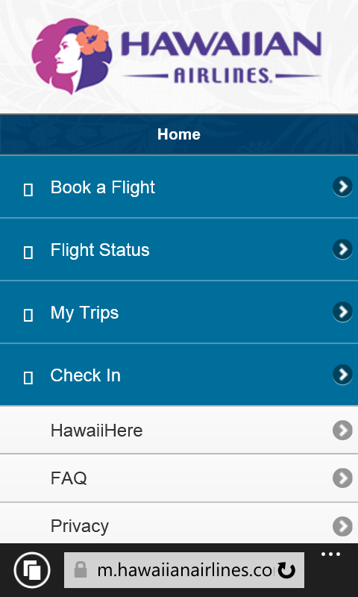
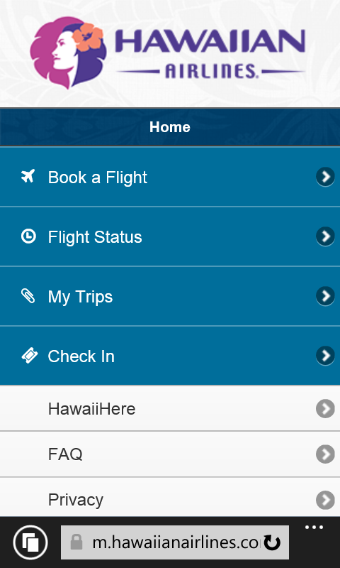
Font Resource Handling
Before loading font resources, IE and Firefox check the font server’s CORS header, and the font’s installable header (as per W3C specification).
This is done to ensure that the font usage rights are honored.
WebKit does not check CORS / installable header.
before
after

Slide 15
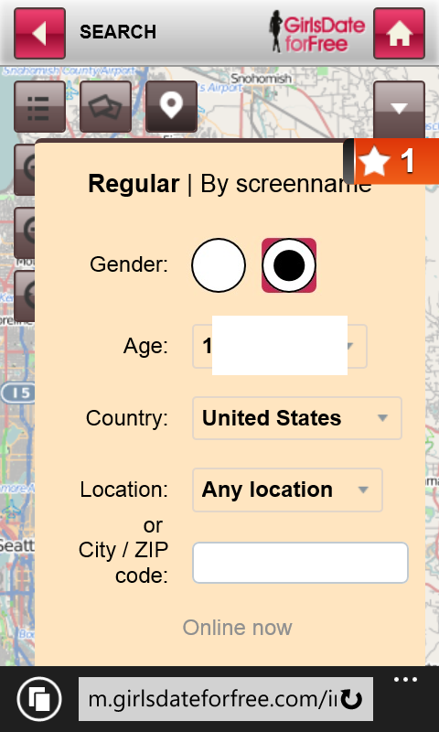
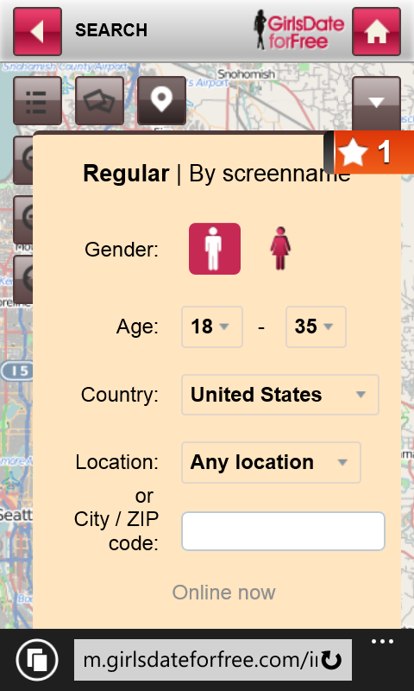
Control Appearance Overrides
Some sites restyle input controls using -webkit-appearance: none for critical functionality.
before
after

Slide 16

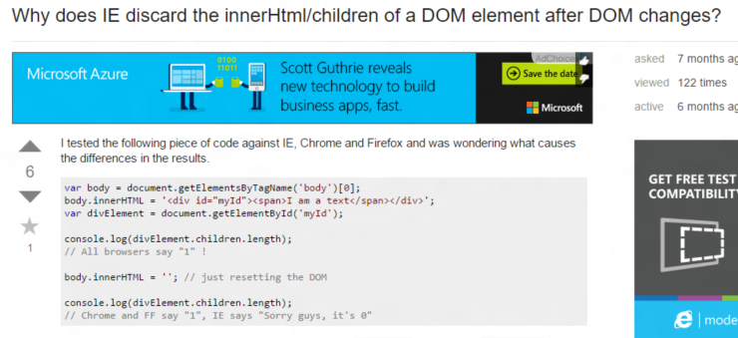
innerHTML orphaned children

Slide 17
Interop patterns we’re working on
Bugs where we’re just plain wrong
Standards we’re missing
Unstandardized but interoperable APIs
“defacto” differences from standards
Bugs in other browsers
innerHTML orphaned children
Web audio, preserve-3d, RTC, CSP, responsive images
-webkit-appearance, <meta viewport>
<meta http-equiv="refresh" content="0;http://foo.com" />
body.scrollTop versus documentElement.scrollTop, DOM prototypes

Slide 18

To date, we’ve made
of these types of fixes in Edge.

Slide 19
Removing code (yay!)
attachEvent()
currentStyle
VML
X-UA-Compatible
IE Layout Quirks
VB Script
currentStyle
Conditional Comments
MS-prefixed Events
Notes:
It makes developers really happy to remove code. Like really happy.
I tried to enumerate all the IEisms we’ve removed, but I just couldn’t.

Slide 20
220k+
Unique LoC Removed
6 document modes
300+ APIs removed
300k+
Unique LoC Added
49 New Major Features
4200+ Interop Fixes

Slide 21
Standards and our roadmap

Slide 22
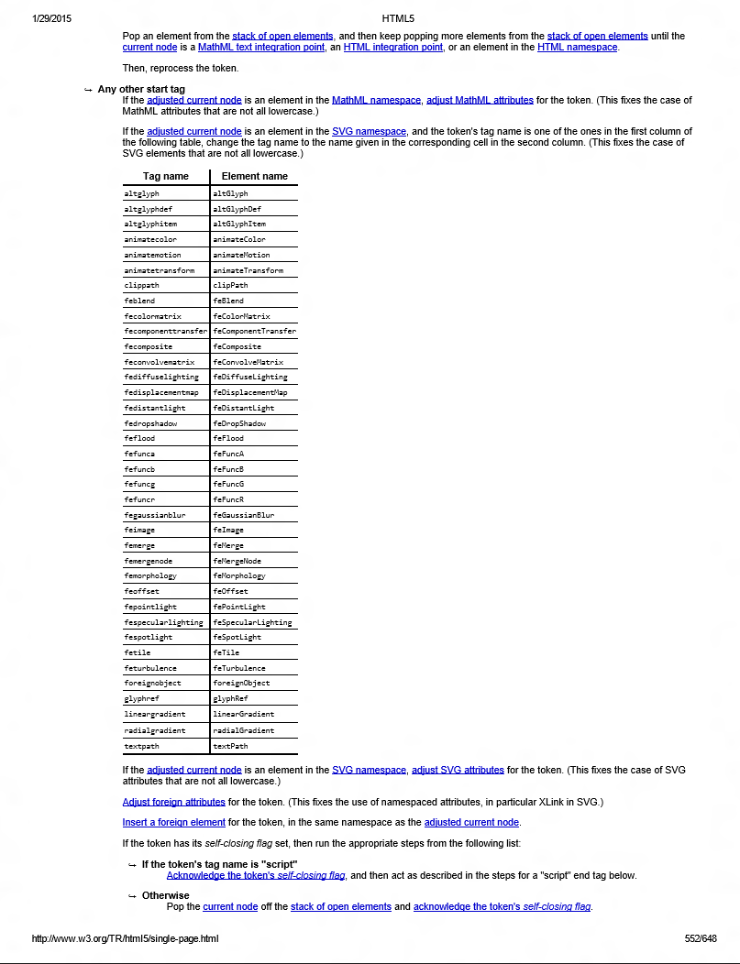
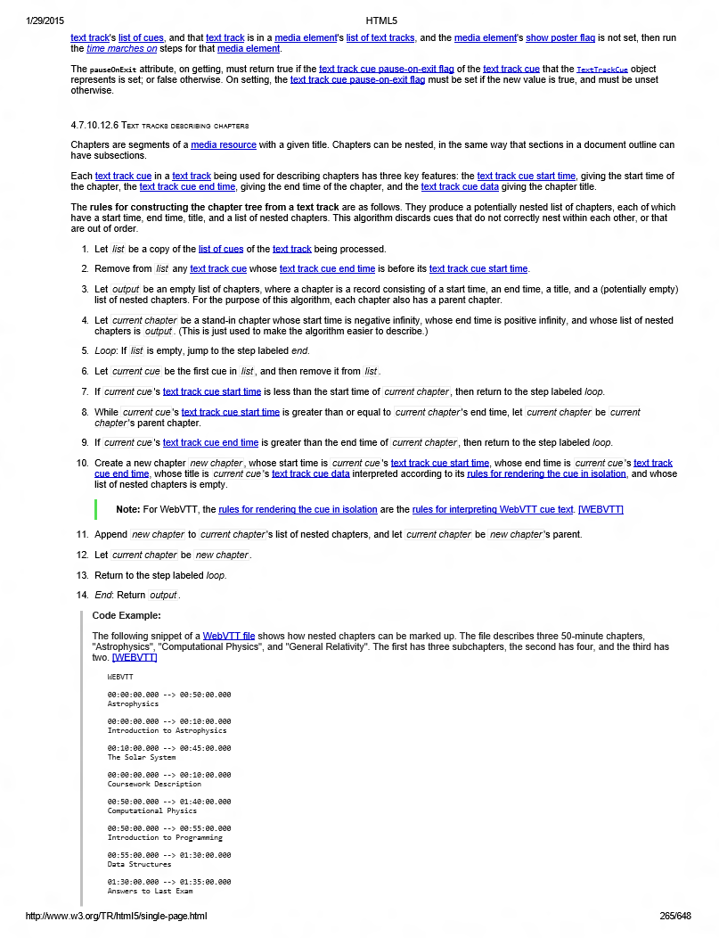
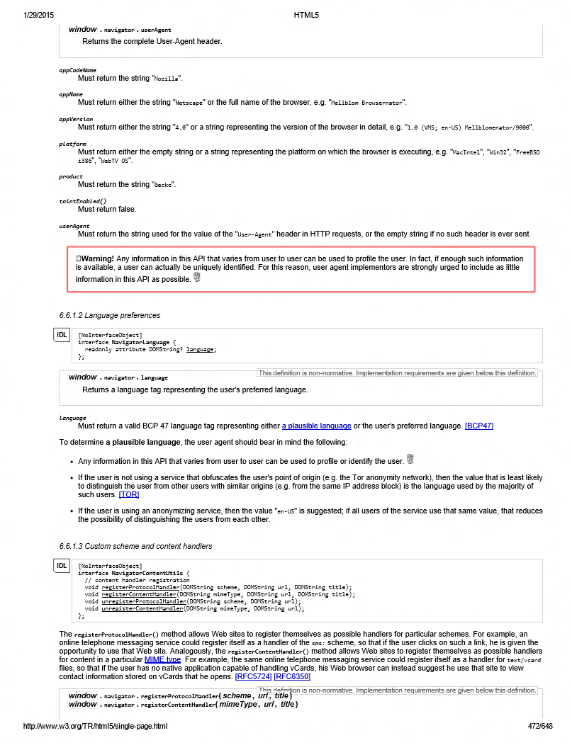
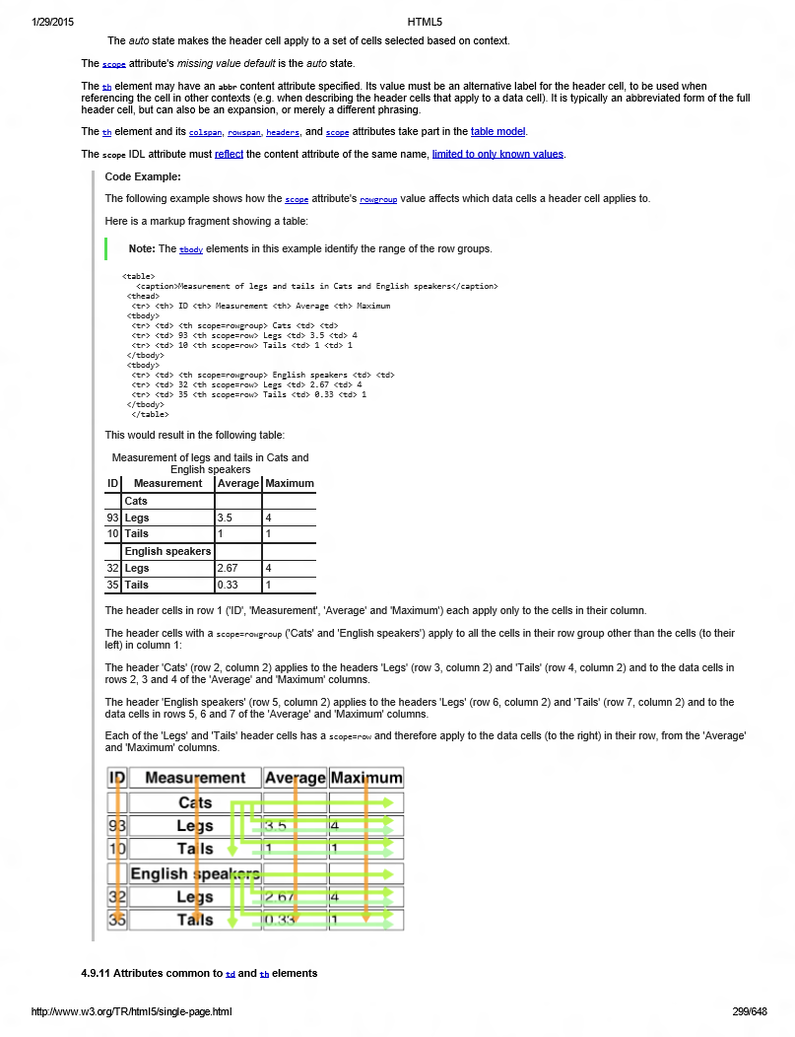
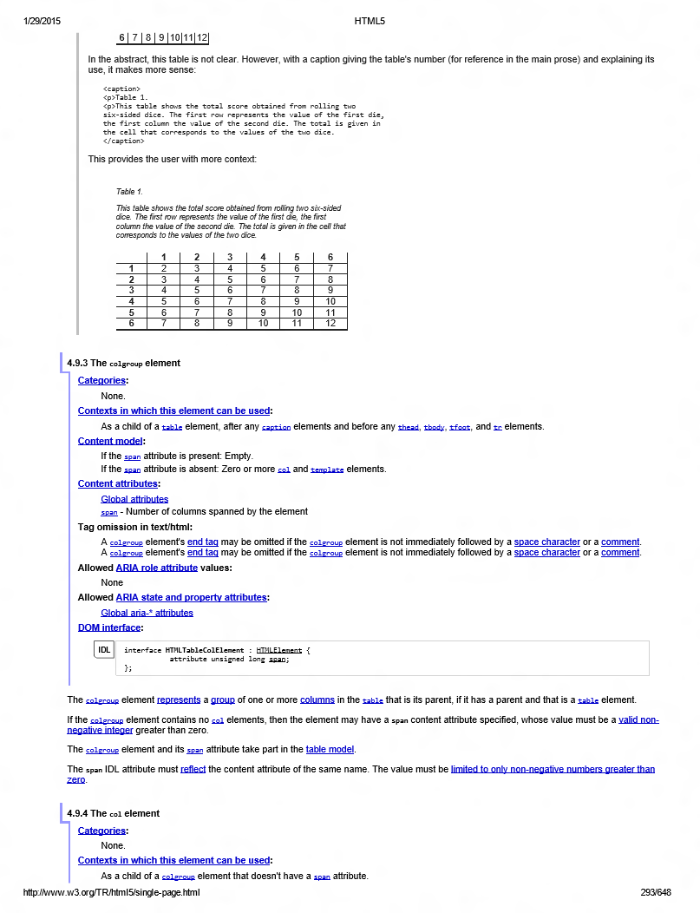
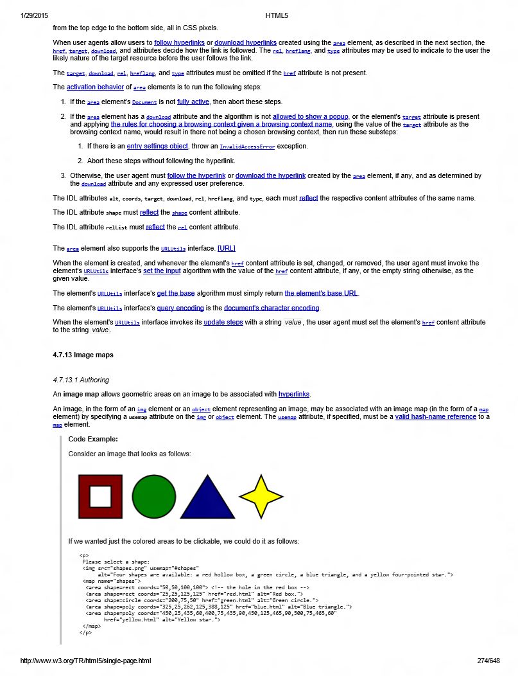
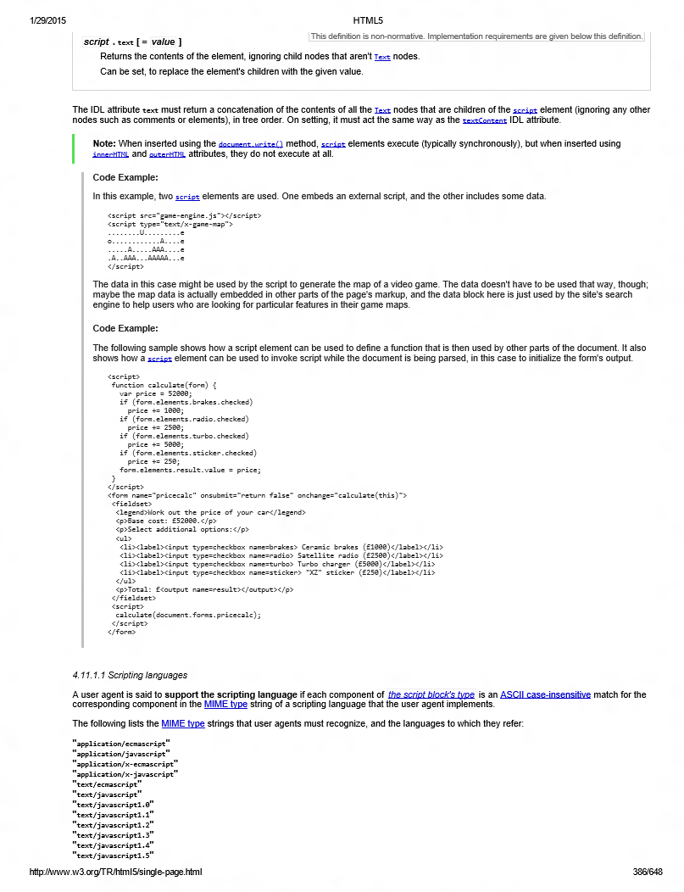
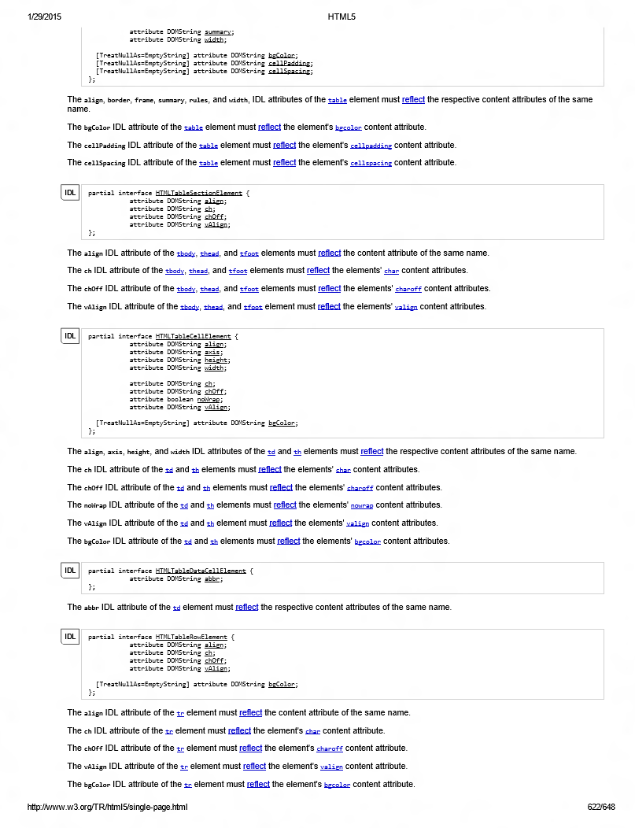
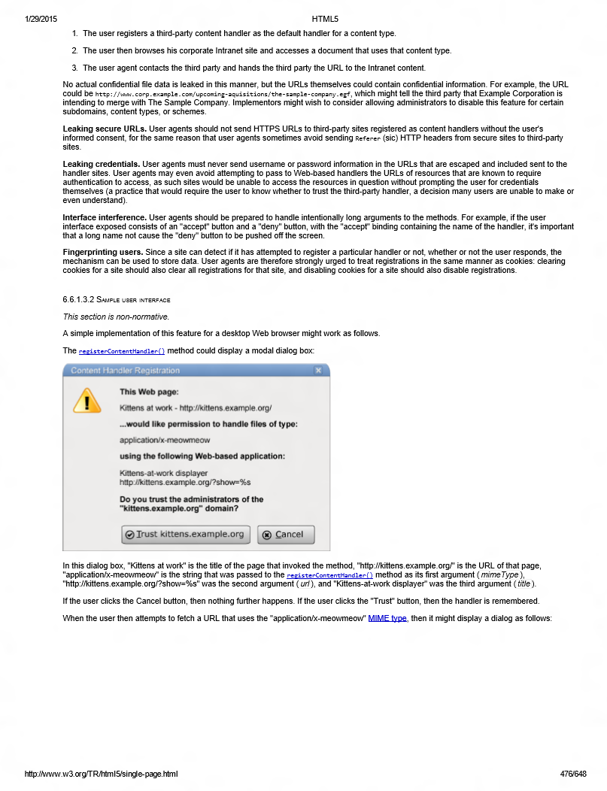
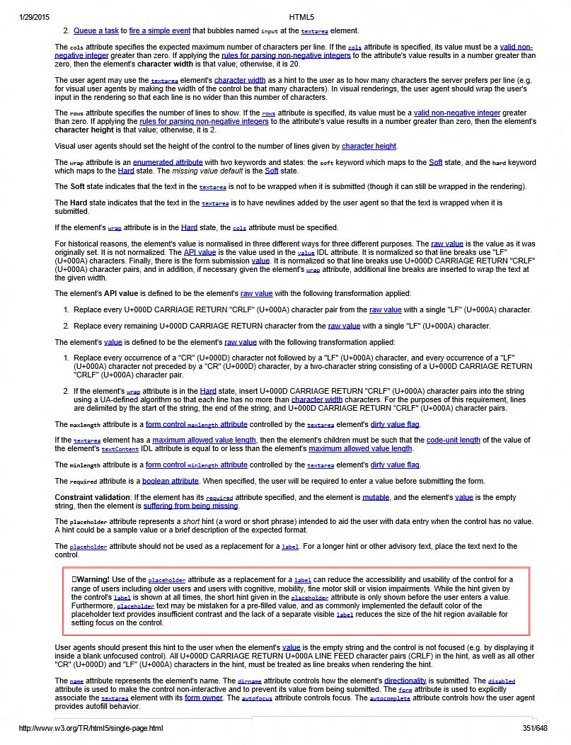
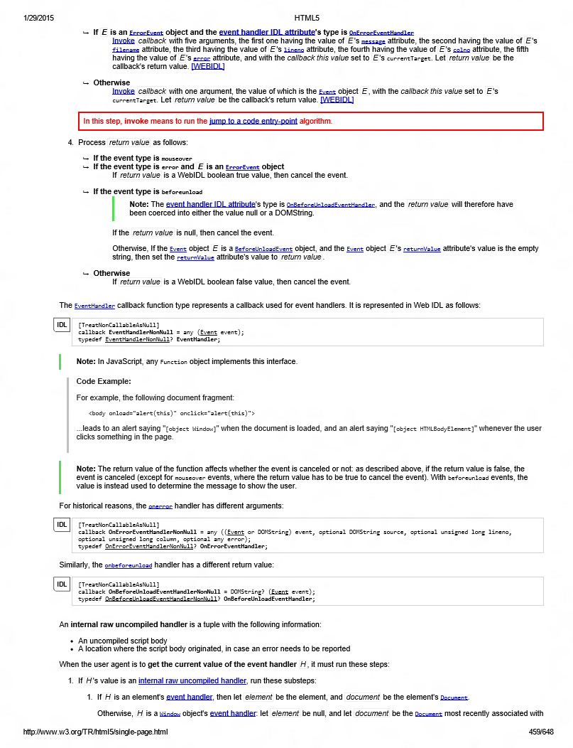
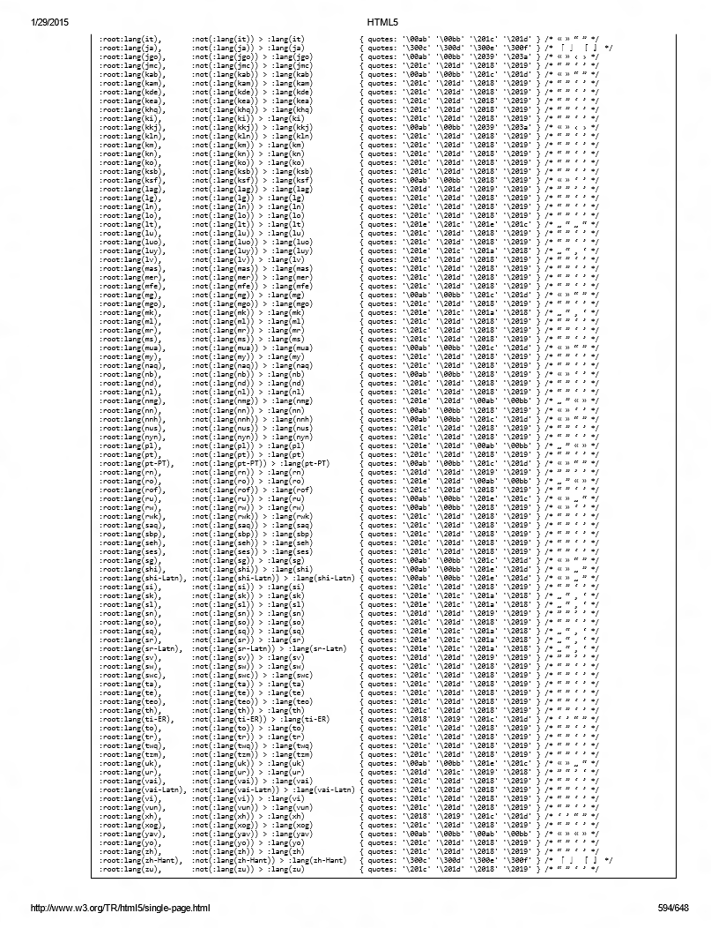
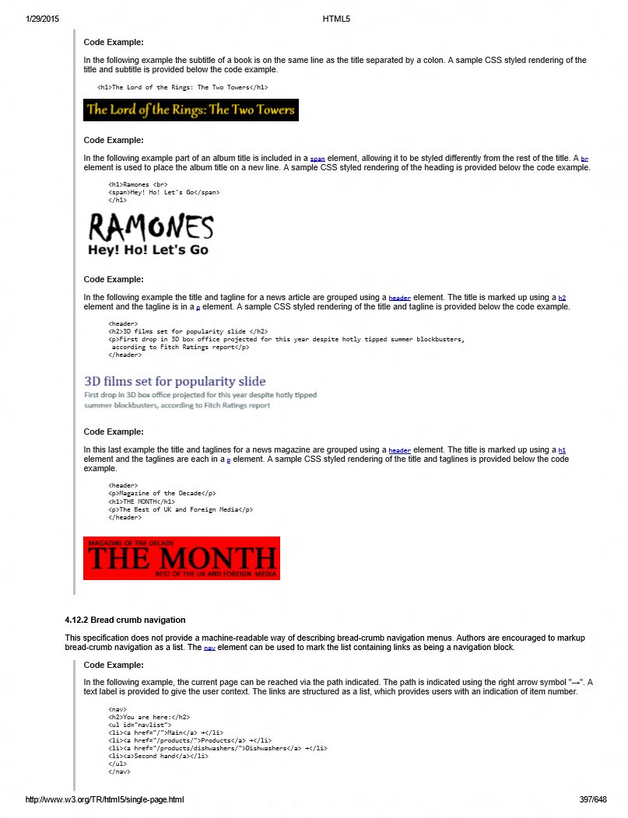
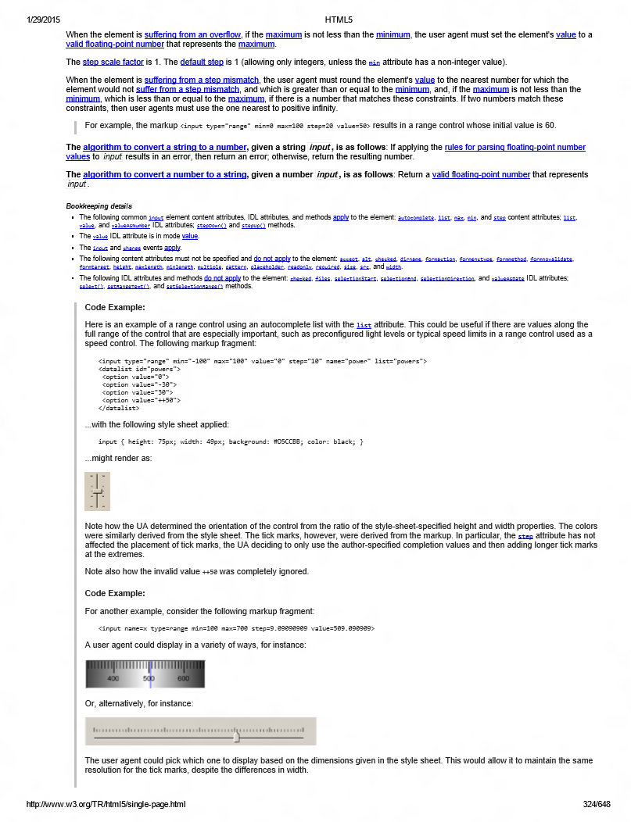
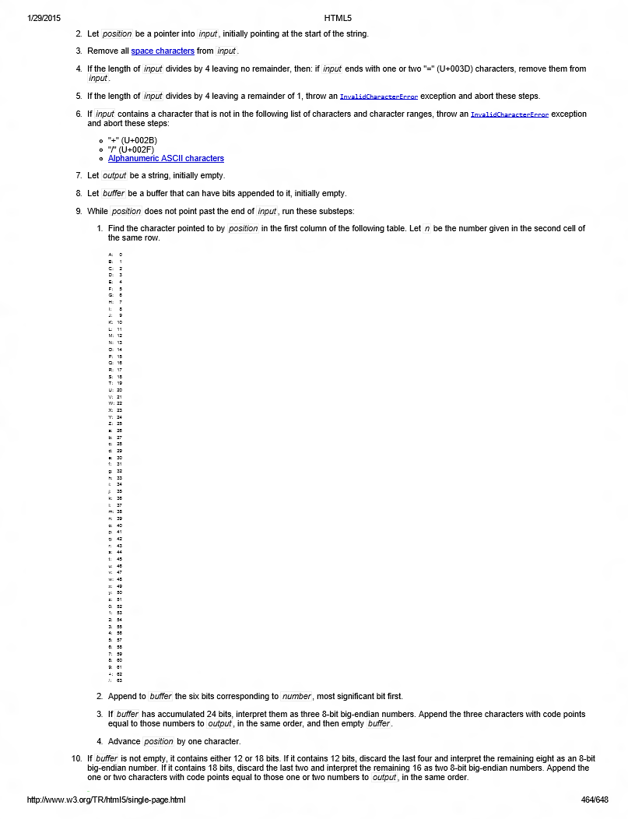
Specifications… oh my!

Slide 23
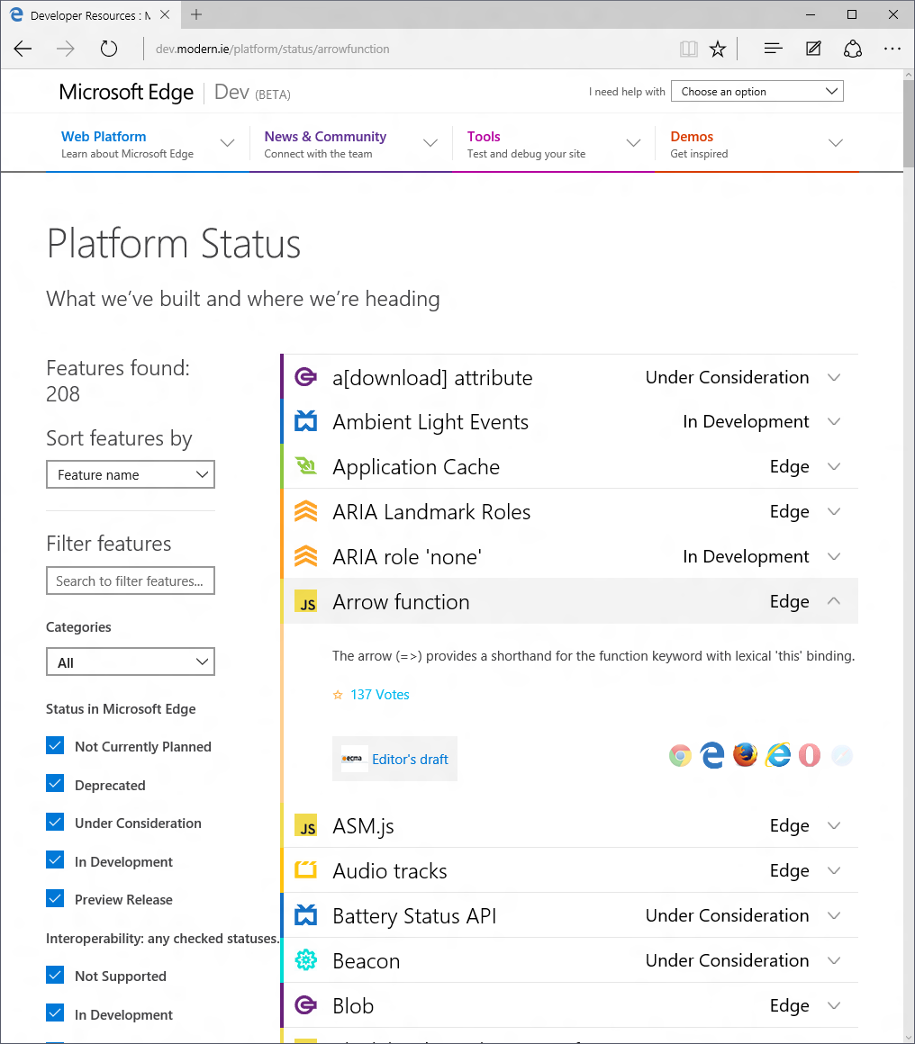
Planning in the open
http://dev.modern.ie/platform/status/

Slide 24
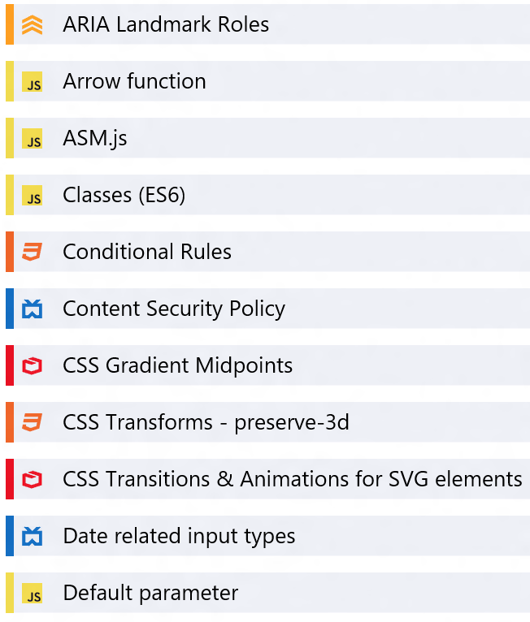
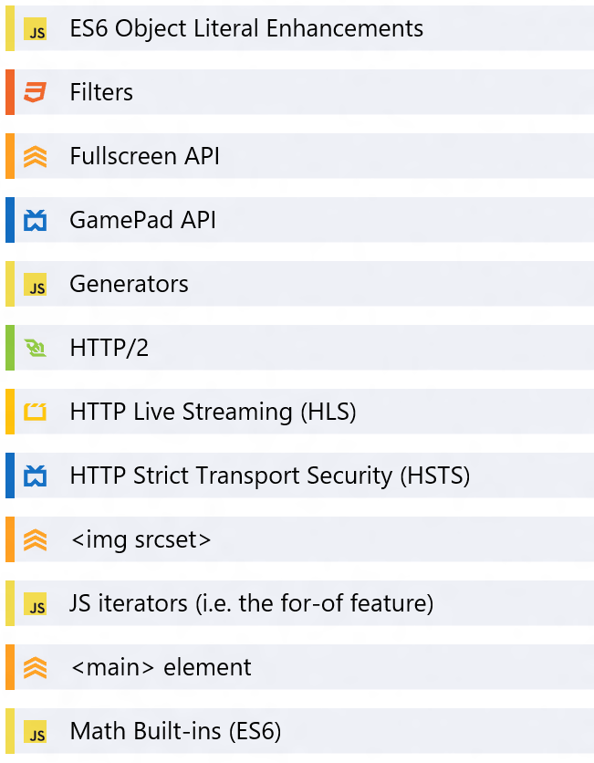
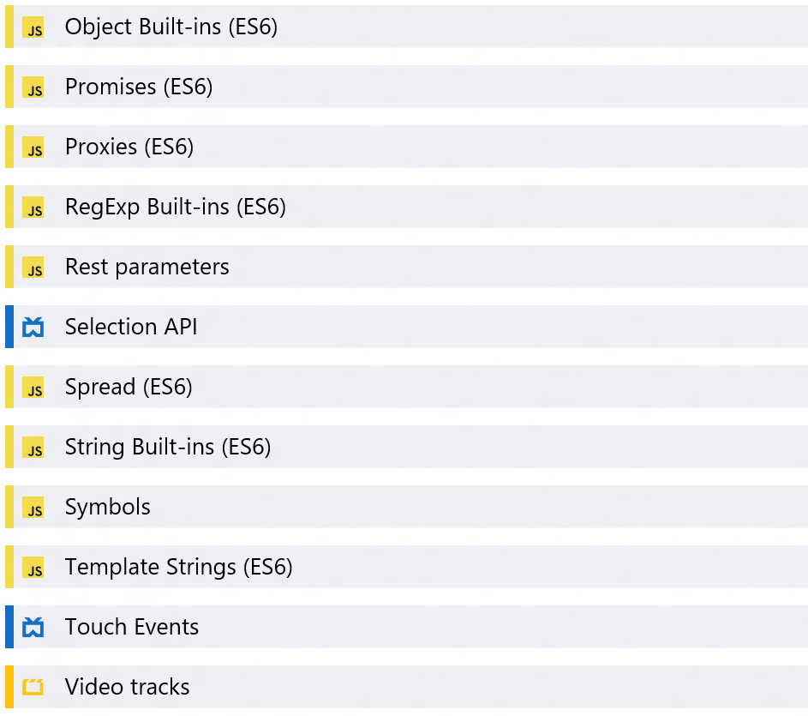
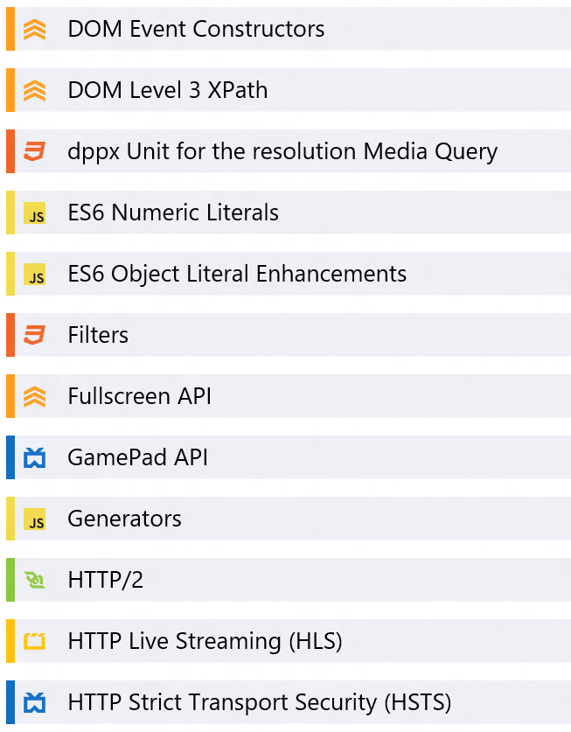
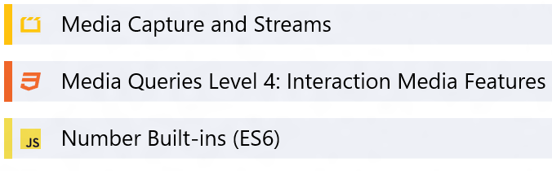
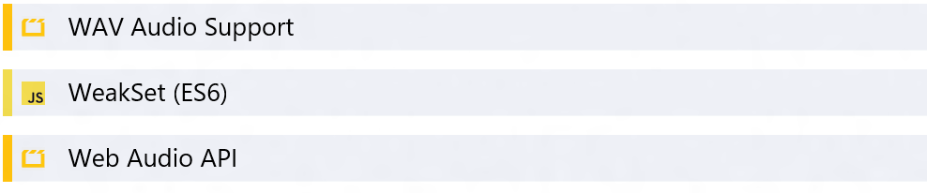
What’s available in Microsoft Edge now

Slide 25
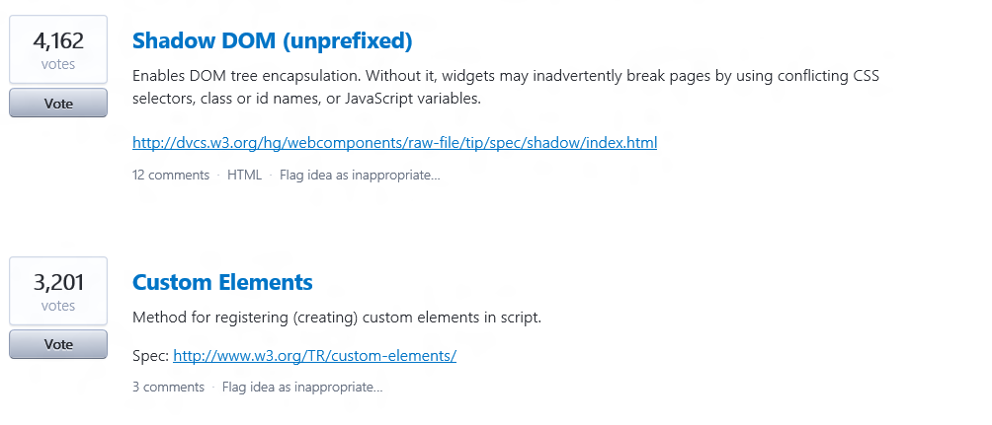
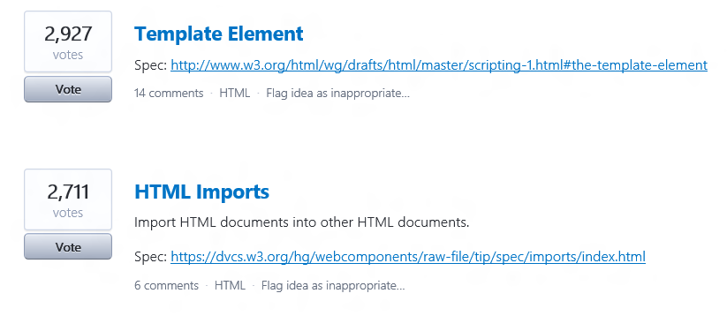
How we think about what’s beyond that
Real World Usage Data
Developer/Partner Feedback
http://uservoice.modern.ie
Standards Stability
Development Capacity

Slide 26
Testing Compatibility

Slide 27
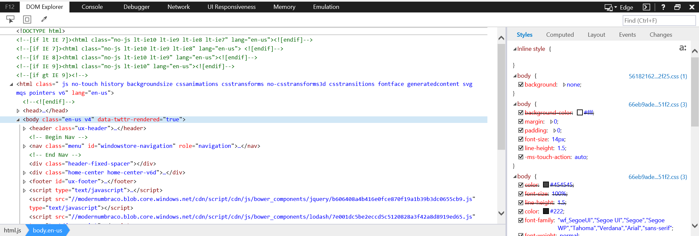
F12 Tools

Slide 28

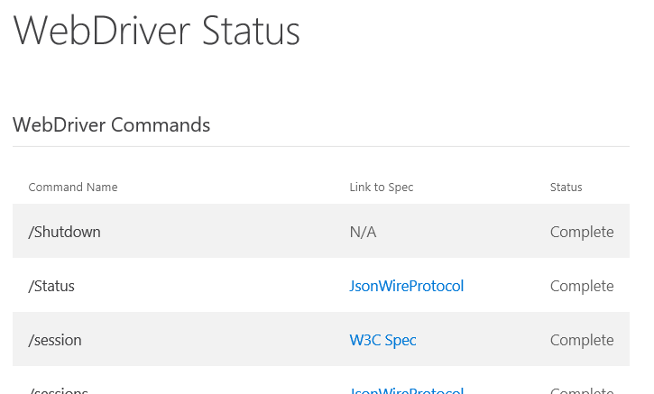
WebDriver
WebDriver is available for Microsoft Edge
WebDriver is an emerging standard through which Web developers can write tests to automate Web browsers for site testing.
Status of WebDriver features is available
🔗 http://aka.ms/msedgecompat

Slide 29

http://dev.modern.ie
Microsoft Edge / IE Virtual Machines
RemoteIE (RemoteEdge on the way)
Site Scanner
Changelog
Demos
Documentation
🔗 http://aka.ms/msedgecompat
“--”

Slide 30
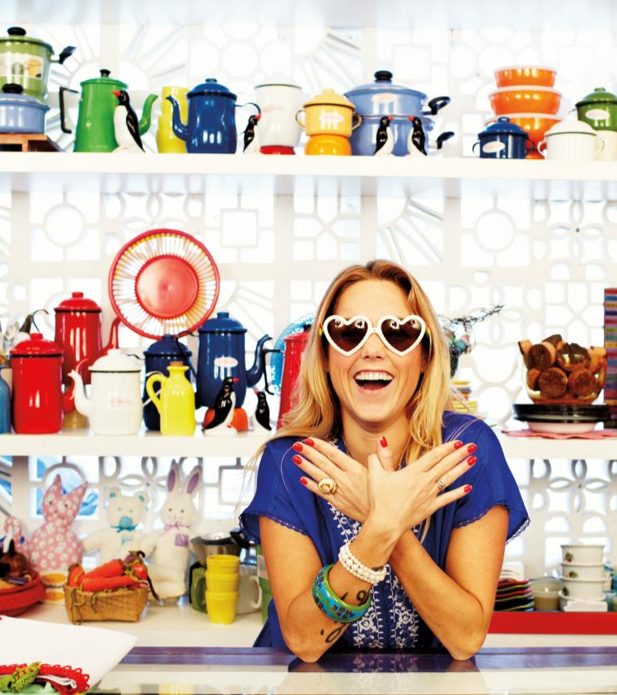
insider.windows.com
🔗 http://aka.ms/msedgecompat
“--”

Slide 31
What’s next?

Slide 32
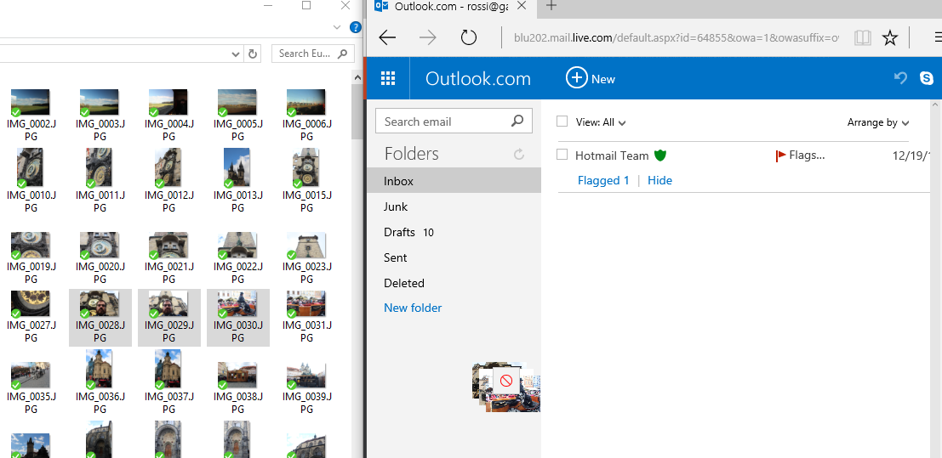

Drag Drop


Slide 33
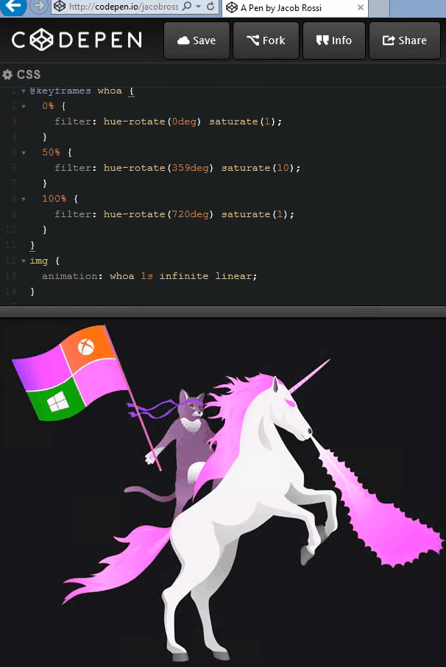
CSS Filter Effects


Slide 34
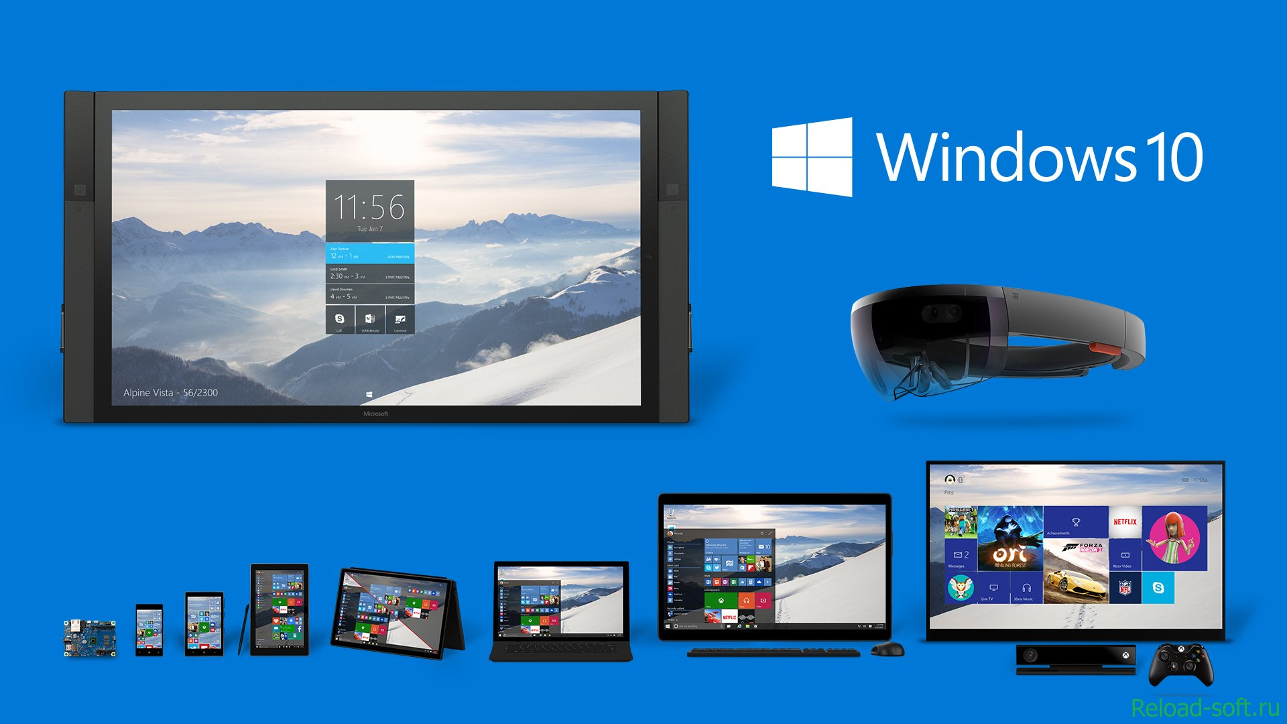
(More) Responsive Images
 Shipped
<img srcset>
<img srcset sizes>
<picture>
 In Development
 In Development

Slide 35
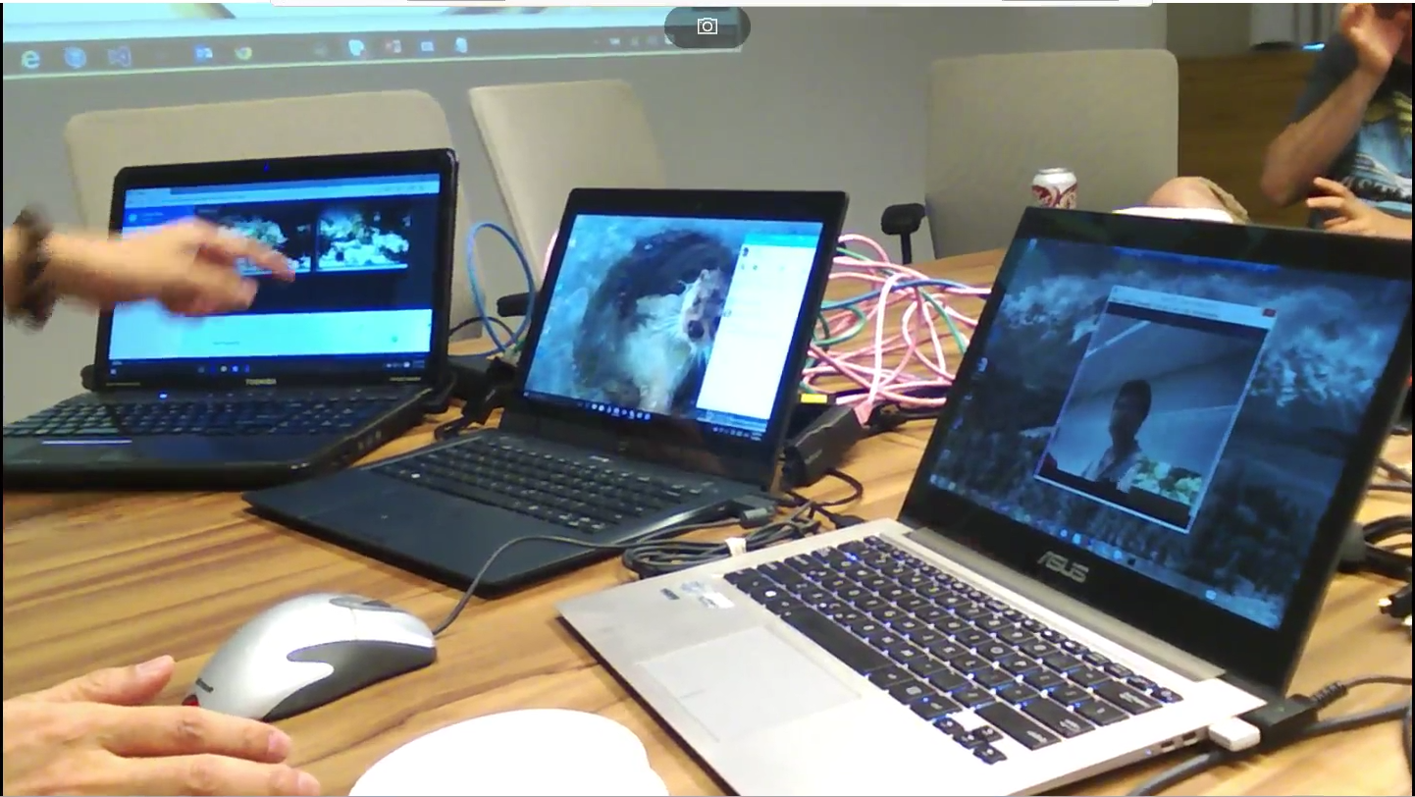
Real Time Communication - ORTC


Slide 36

Web Components
 In Development
<template>
 Up 2nd
ShadowDOM
 Up 3rd
Custom Elements
 Standards Issues
HTML Imports

Slide 37
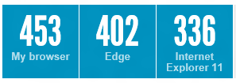
HTML5Test.com
While this test doesn’t map to what the web uses OR web devs ask us for,
it’s increasingly a top “benchmark” used in browser preference.

Slide 38
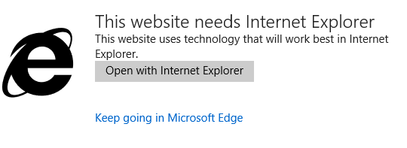
Enterprise Improvements

about:compat – view the CV list
NeedEdge – switch users from IE to MS Edge
Improved IT Pro controls for settings, security, and features

Slide 39
And more!
The Microsoft Edge Developer Portal http://dev.modern.ie/
Important Microsoft Edge URLs for Devs https://blogs.msdn.microsoft.com/benriga/2015/11/10/important-microsoft-edge-urls-for-devs-2/
Platform status https://dev.windows.com/en-us/microsoft-edge/platform/status/
Quick site scan https://dev.windows.com/en-us/microsoft-edge/tools/staticscan/
Generate Screenshots https://dev.windows.com/en-us/microsoft-edge/tools/screenshots/

Slide 40
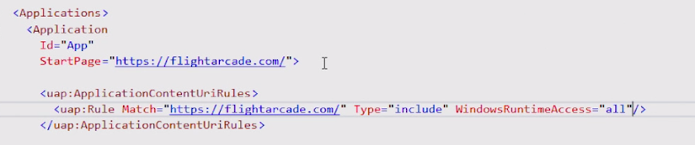
Project Westminster (Hosted Web Apps)
Packaging of a website as a universal application
The Windows Bridge for web apps makes it easy to publish your responsive web app to the Windows Store as a Universal Windows Platform (UWP) app, while reusing your existing code and workflow.
Easily scale your responsive web app to different devices.
Interact with native Windows APIs from JavaScript running on your website.
Integrate with Cortana voice commands.
Debug your app with Microsoft Edge F12 Developer Tools.
Track status, ratings, and reviews, see analytics, and get paid for all of your Windows app in the Windows Store.
Updates should be pushed to web-server not the app.

Slide 41
Project Westminster (Hosted Web Apps)
Invoke UWP API from remote JavaScript code
if (typeof Windows !== 'undefined'&&
typeof Windows.UI !== 'undefined' &&
typeof Windows.UI.Notifications !== 'undefined') {
var notifications = Windows.UI.Notifications,
tile = notifications.TileTemplateType.tileSquare150x150PeekImageAndText01,
tileContent = notifications.TileUpdateManager.getTemplateContent(tile),
tileText = tileContent.getElementsByTagName('text'),
tileImage = tileContent.getElementsByTagName('image');
tileText[0].appendChild(tileContent.createTextNode(message || 'Demo Message'));
tileImage[0].setAttribute('src', imgUrl || 'https://unsplash.it/150/150/?random');
tileImage[0].setAttribute('alt', imgAlt || 'Random demo image');
var tileNotification = new notifications.TileNotification(tileContent);
var currentTime = new Date();
tileNotification.expirationTime = new Date(currentTime.getTime() + 600 * 1000);
notifications.TileUpdateManager.createTileUpdaterForApplication().update(tileNotification);
}

Slide 42
Q&A
Oleksandr Krakovetskyi
CEO DevRain Solutions
alex.krakovetskiy@devrain.com

